Slide 1





Consumer Goods Adhoc Insights
A journey through the AtliQ Hardware

Slide 2
Introduction and Problem Statement
AtliQ Hardware (imaginary company) is one of the leading computer hardware producers in India and well expanded in other countries too.
However, the management noticed that they do not get enough insights to make quick and smart data-informed decisions. They want to expand their data analytics team by adding several junior data analysts. They wanted to hire someone who is good at both tech and soft skills. Hence, they decided to conduct a SQL challenge which will help them to understand both the skills.

Slide 3
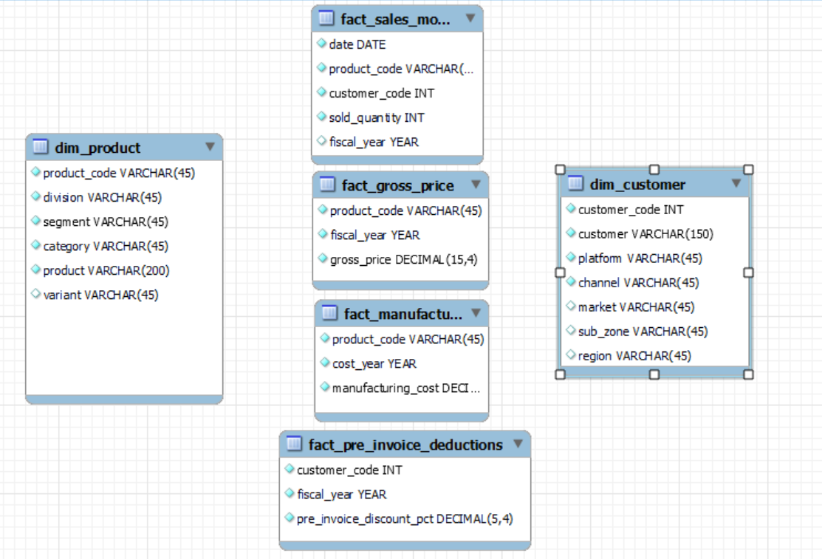
Input Data
Input data consists of sales data for FY 2020 and FY 2021 along with different Dimensions table like Customer details, product details etc.

Slide 4
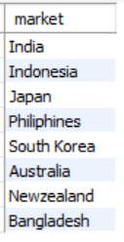
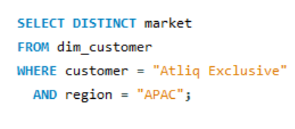

1. Provide the list of markets in which customer "AtliQ Exclusive" operates its business in the APAC region..

Slide 5
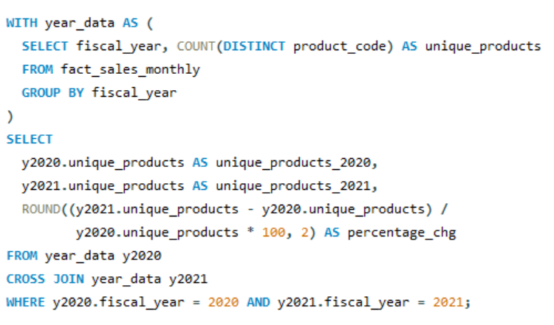
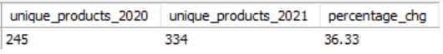
2. What is the percentage of unique product increase in 2021 vs. 2020?

Slide 6
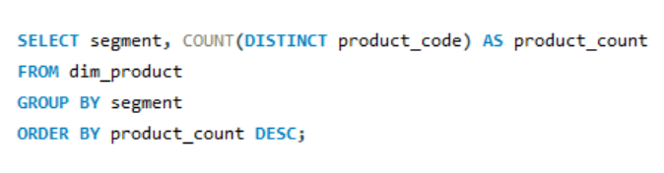
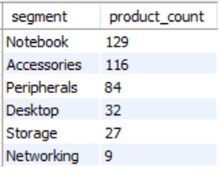
3. Provide a report with all the unique product counts for each segment and sort them in descending order of product counts.

Slide 7
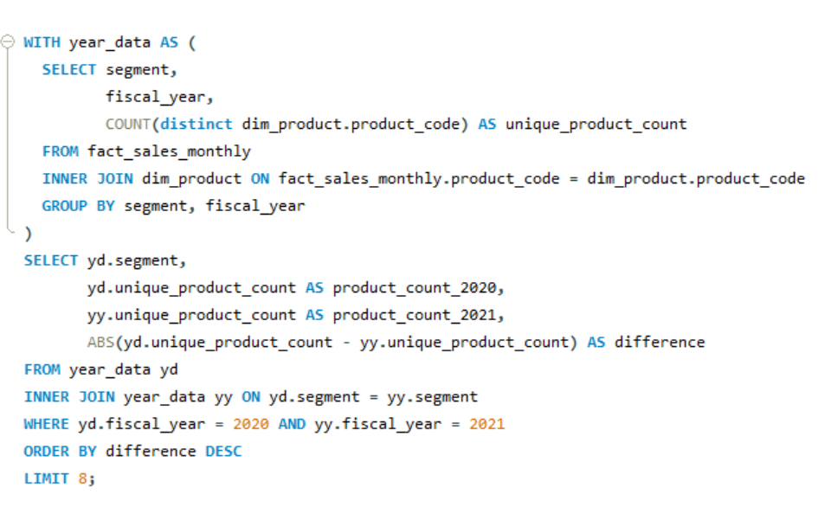
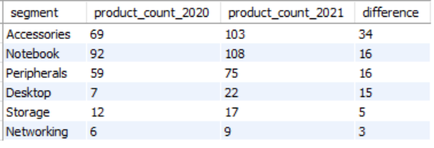
4. Which segment had the most increase in unique products in 2021 vs 2020?

Slide 8
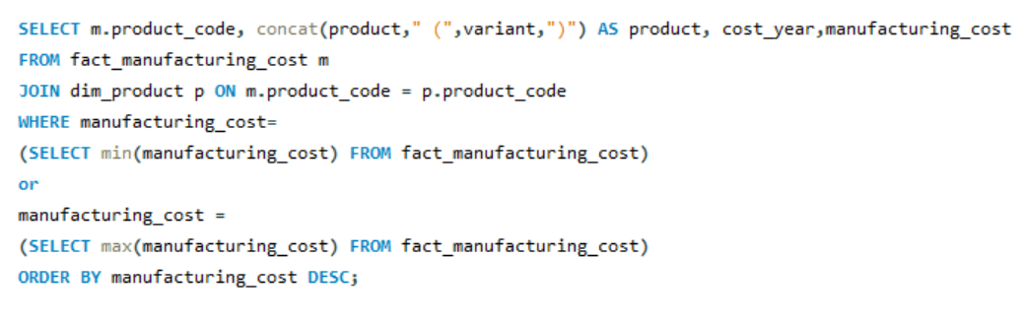
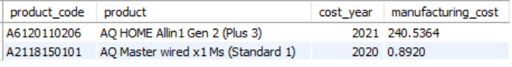
5. Get the products that have the highest and lowest manufacturing costs.

Slide 9
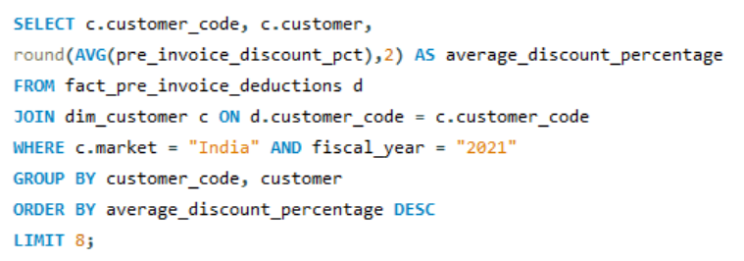
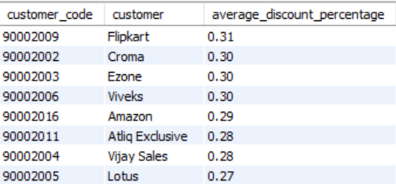
6. Generate a report which contains the top 5 customers who received an average high pre_invoice_discount_pct for the fiscal year 2021 and in the Indian market.

Slide 10
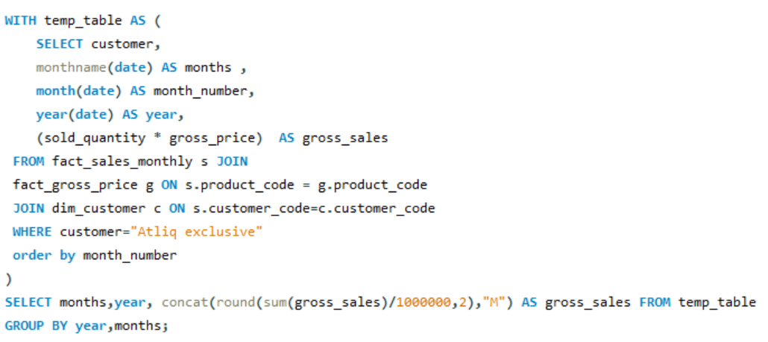
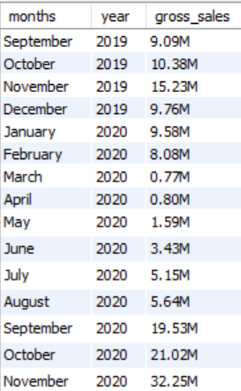
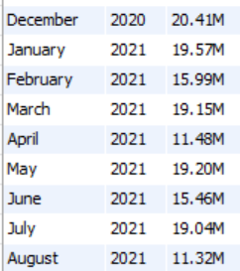
7. Get the complete report of the Gross sales amount for the customer “Atliq Exclusive” for each month. This analysis helps to get an idea of low and high-performing months and take strategic decisions.

Slide 11
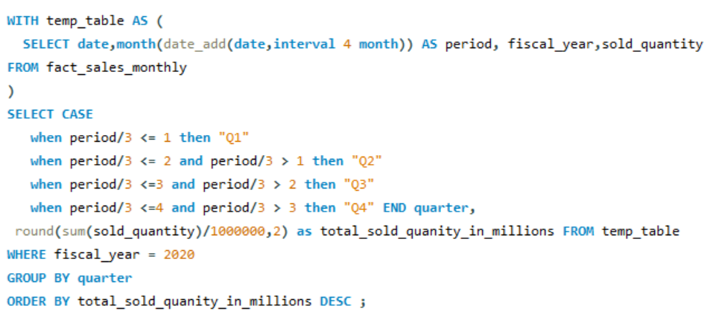
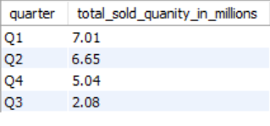
8. In which quarter of 2020, got the maximum total_sold_quantity?

Slide 12
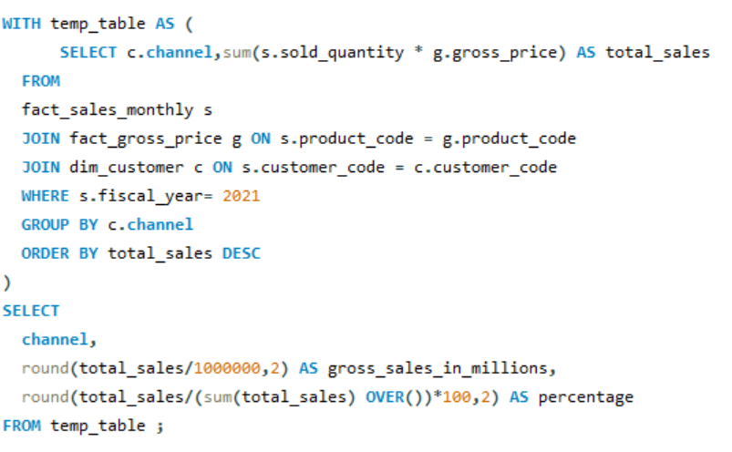
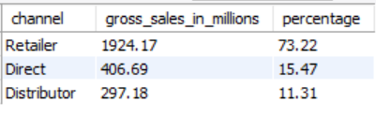
9. Which channel helped to bring more gross sales in the fiscal year 2021 and the percentage of contribution?

Slide 13
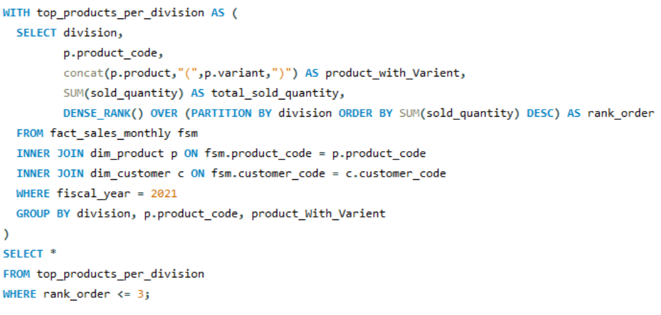
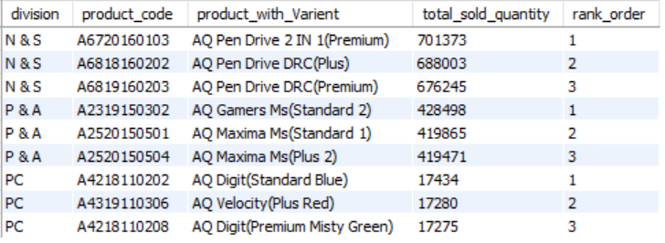
10. Get the Top 3 products in each division that have a high total_sold_quantity in the fiscal_year 2021?

Slide 14
Thank You

